Slide 1

Get started with Microsoft PowerApps and Flow

Slide 2
Agenda
Module 1: Get started with Microsoft PowerApps​
Module 2: PowerApps Hands-on Lab
Module 3: Get started with Microsoft Flow
Module 4: Flow Hands-on Lab
Module 5: PowerApps and Flow Hands-on Lab
Module 6: Playing with these tools

Slide 3
Lesson 1.1 Power Platform Community

Slide 4
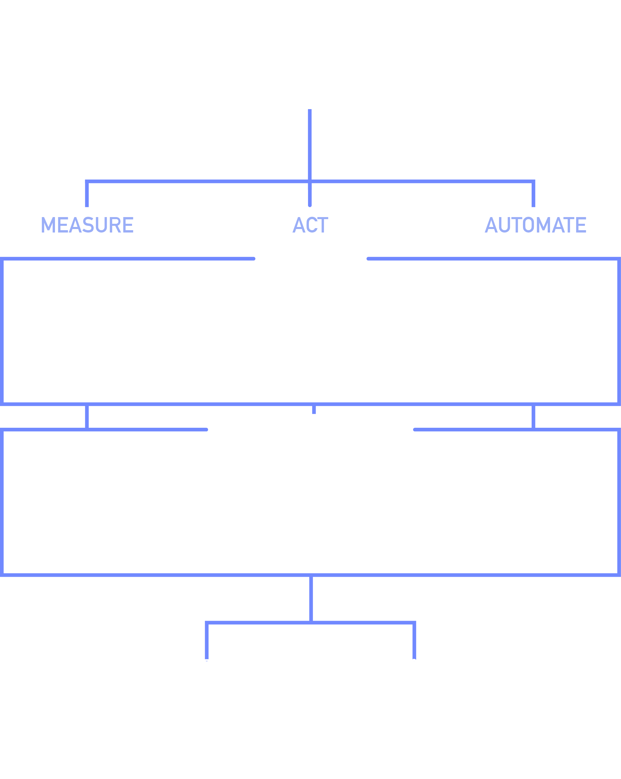
Business Application Platform Innovation
Innovate faster
Power users build “no code” solutions
Create mobile business apps with clicks, ‘not code’
Enterprise Developers and IT pros
Extend capabilities for power users
Rich platform services with power of Azure
App Services, Service Fabric, Azure Functions, Logic Apps, API Management, BizTalk…Turn your data into apps
Connects to everywhere, securely
It works on all devices, Easy to deploy and test
https://powerusers.microsoft.com/ https://businessplatform.microsoft.com/en-us/

Slide 5
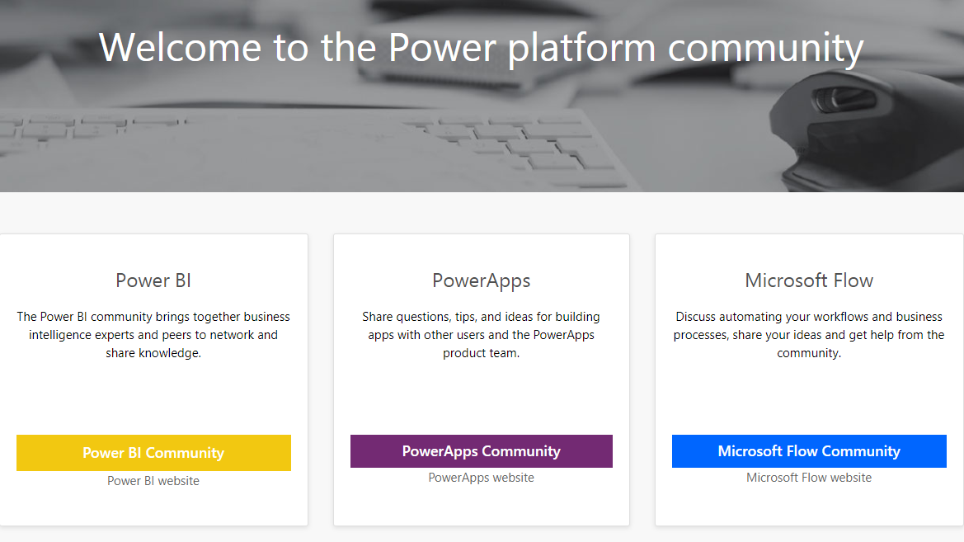

Slide 6
Businesses need to deliver apps in a way that stays extensible, connected, secure and fast
ACT
PowerApps
AUTOMATE
Flow
Connectors to Data and APIs

